Slide 1


Application for Stress Management/ Mood-Based
Recommendation System
CMPE 295B
Spring 2024
San Jose State University
HARSHIT CHOUKSEY
ASHISH GAURAV
SAYALI NILANGEKAR
SANKALP TIWARI
Under the guidance of: Dr. Wencen Wu

Slide 2
INTRODUCTION
Mental stress is on the rise across age groups, leading to serious consequences.
External factors have a profound impact on our emotions and overall well-being.
Existing stress management tools often fall short in addressing individuals' unique stressors and emotional states.
The ultimate goal of this project is to alleviate mental stress and enhance overall moods in modern society.

Slide 3

03. SYSTEM DESIGN

Slide 4
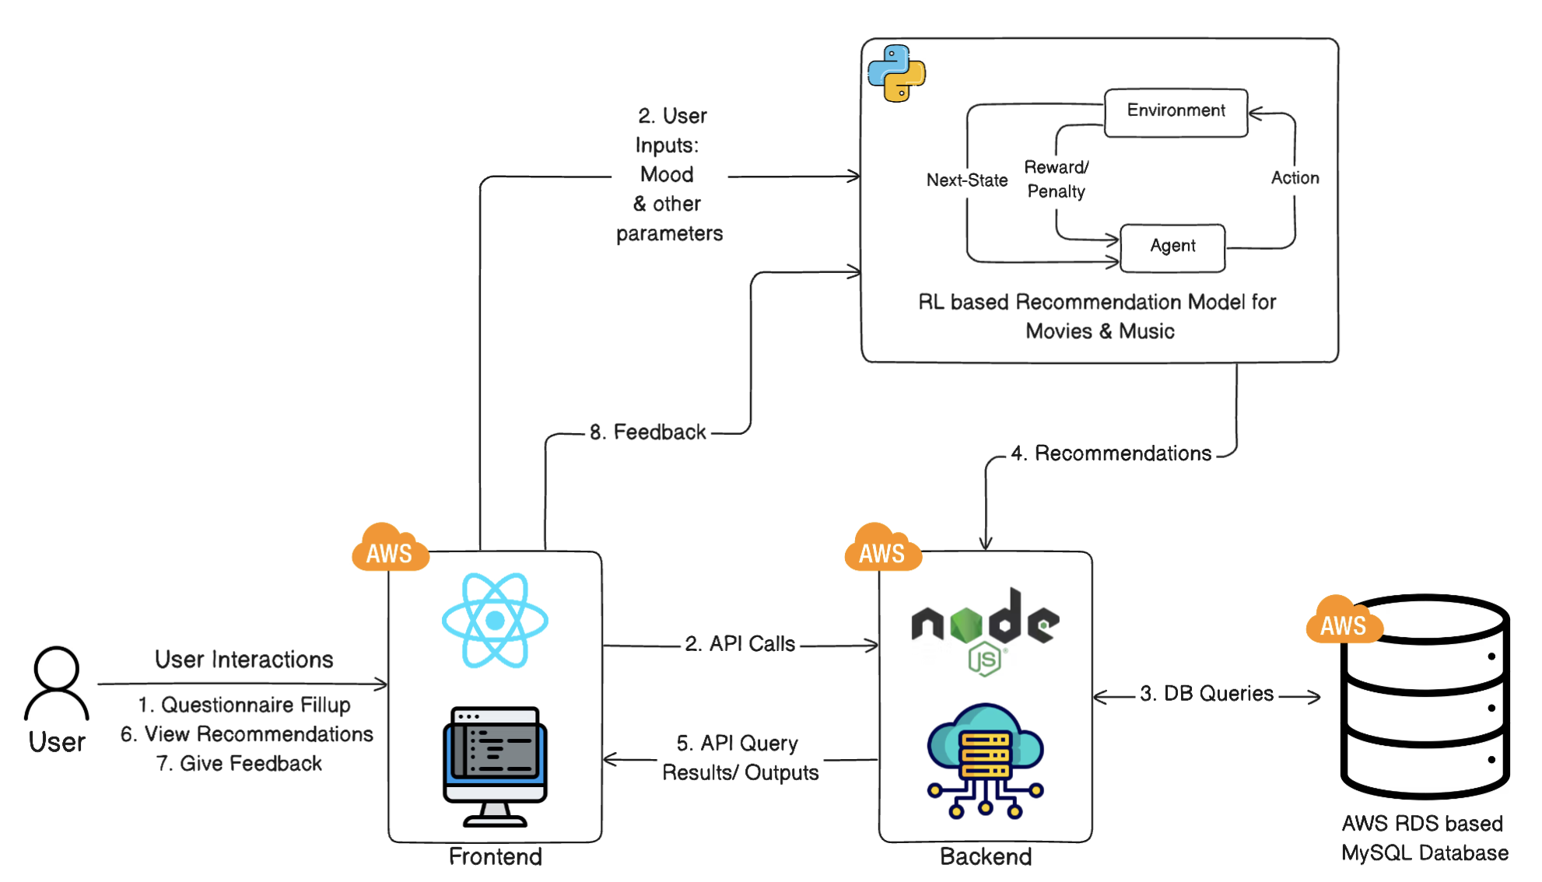
System Architecture

Slide 5

MOOD-BASED RECOMMENDATION SYSTEM
Web application with a questionnaire for mood detection
Techstack: ReactJS, NodeJS, Python, MySQL, AWS
Utilize the leading algorithms for
Movie recommendations - Content-based Filtering
Music recommendations - Random Forest Classifier
Integrate the recommendation algorithm with mood-based features
Integrate user feedback to improve suggestions
Notes:
So as Sankalp said, the tech stack we have finalized is..
Finalized models

Slide 6

04. MACHINE LEARNING MODELS

Slide 7
MUSIC RECOMMENDATION models explored
01
K-nearest neighbors
02
Multi-output Random Forest Classifier
03
Collaborative Filtering
Simple algorithm based on nearest training examples in feature space.
Challenges with scalability and accuracy in high-dimensional, sparse music data.
Ensemble of decision trees for predicting multiple outputs.
Effective for complex musical associations but computationally heavy for real-time processing.
Utilizes user-item interactions for personalized recommendations.
Adapts to user preferences over time but faces challenges with new users and items (cold start problem).

Slide 8
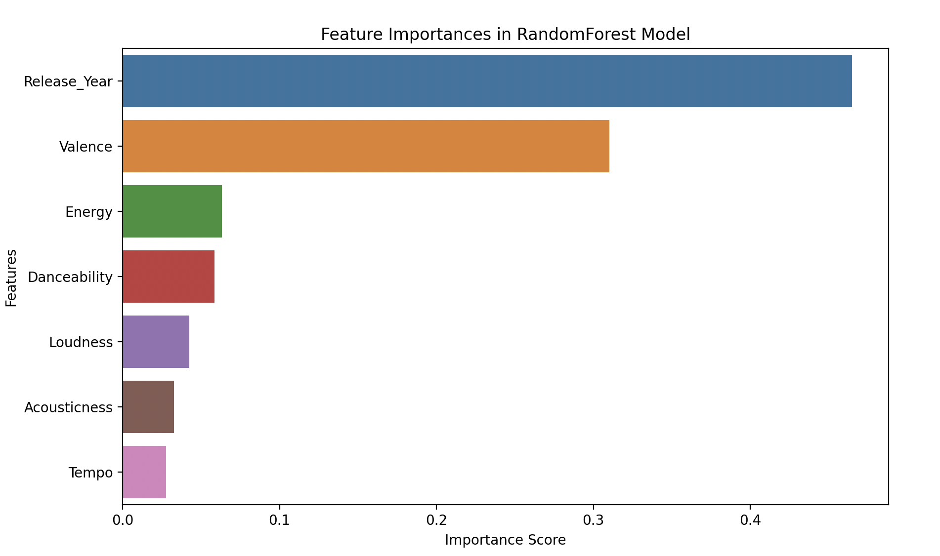
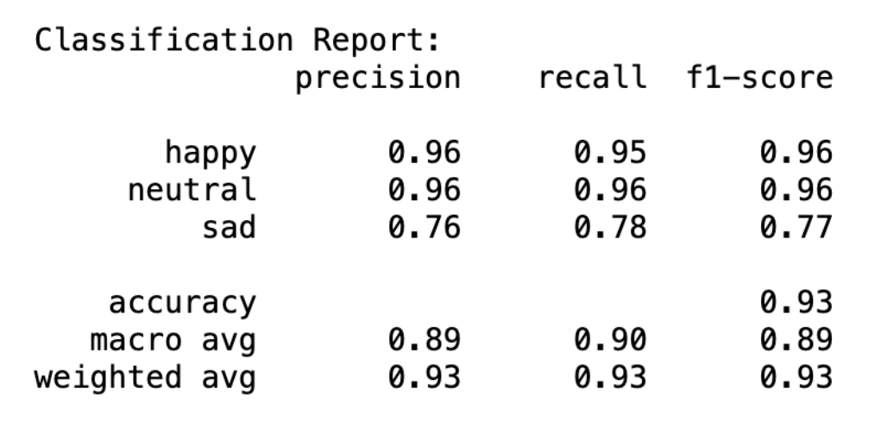
FINAL MUSic MODEL: RANDOM FOREST CLASSIFIER WITH FILTRATION
Robust Classification Capabilities: leverages an ensemble of decision trees to handle complex, non-linear relationships within the data, making it highly effective for classifying music tracks based on multiple attributes.
Mood-Based Filtering for Enhanced Personalization: Predict the mood of a song, using audio features such as valence and energy. The system then applies a filtering mechanism based on user-input mood preferences, ensuring that the recommendations align with the listener's current emotional state.
Adaptive Recommendations with High Performance: The integration of filtering with Random Forest’s predictive power allows the system to dynamically adapt recommendations in real-time with high accuracy.

Slide 9
movie RECOMMENDATION models explored
01
Deep Neural Network (DNN)
02
Content-based filtering
Capable of capturing subtle and complex relationships between user behaviour and movie features.
Greater potential to handle evolving user preferences.
Due to it being more focused on the complex relationship, it missed our on providing the correct genres for the mood to the users.
A simpler model that gives recommendations based on features like preferred genres for the mood, popularity and vote average.
Since the items are converted to a vector format gives more closer recommendations to the direct choices provided.

Slide 10
FINAL Movie MODEL: content-based filtering
Binarization of Data
Movie Data
User Data
Vectors generated.
Similarity Scores
Output
RESULTS
Perfect precision and recall in providing the correct genre
User Rating vs predicted rating MSE 3.7 and RMSE 1.9
Notes:
Similarly the list of user preferences in genres for particular mood is encoded in binary format.
Similarity scores are calculated using the binarized data and normalized popularity and vote average.
The results are provided by removing the watched movies and sorting by similarity scores.

Slide 11

06. DEMO

Slide 12


Slide 13

THANK you!

